Slide 1
Secure data hiding in images using steganography
CAPSTONE PROJECT
Presented By:
Student Name : Aman Jain
College Name & Department : SBS College Ashta, BCA

Slide 2
OUTLINE
Problem Statement
Technology used
Wow factor
End users
Result
Conclusion
Git-hub Link
Future scope

Slide 3
Problem Statement
To develop a software application that can hide secret messages inside images and to retrieve them using password. It is to be done through encoding and decoding methods using steganography.

Slide 4
Technology used
Category | Libraries/Platforms
Programming Language | Python
Steganography | Stegano - In-built steganography function like LSB (least significant bit).
Encryption | Cryptography AES 128
OS | Windows 11

Slide 5
Wow factors
Invisibility
No one can tell there is hidden data in the image and that can’t be decrypt without a password.
No Image Quality Loss
The final image looks like same as the host image even after embedding data.
Easy to apply
Easy Graphical UI helps even non-tech users to apply the steganography.

Slide 6
End users
Government & Military
Intelligence agencies for converting communication.
Corporates
Banks & financial institutions to protect confidential data.
Tech companies to safeguard proprietary information.
General Users
Sending hidden messages to remain anonymous.
Military organizations to securely exchange sensitive communication.
privacy and data security for people who are concerned about privacy.

Slide 7
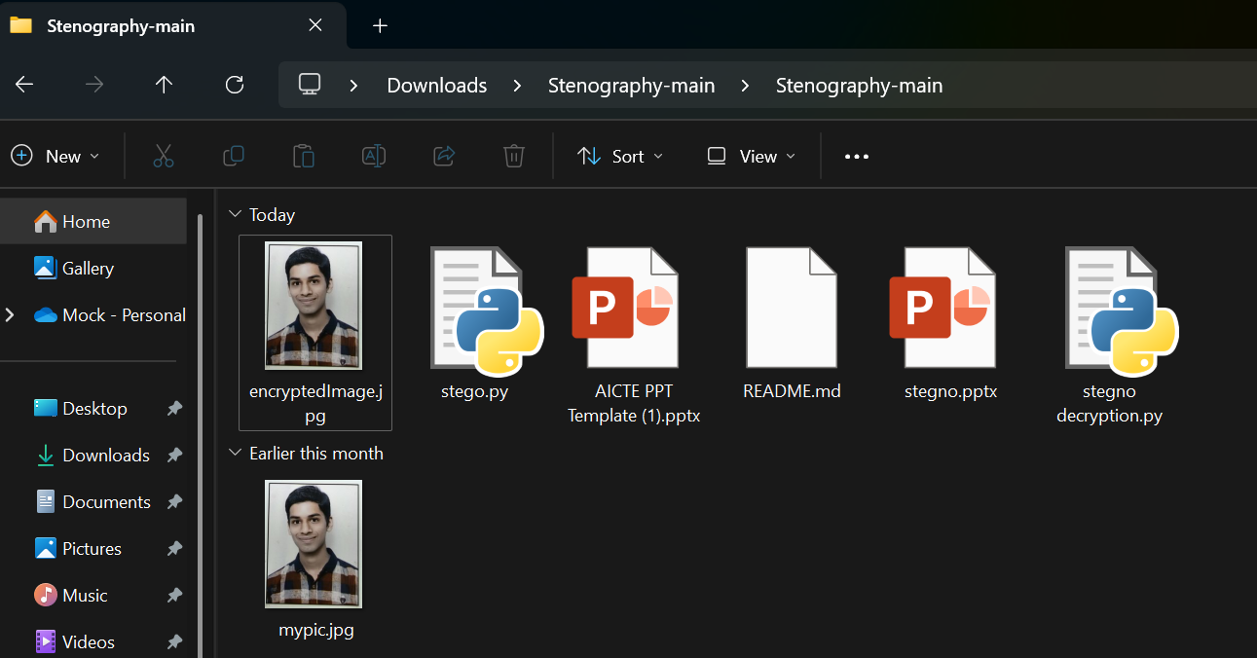
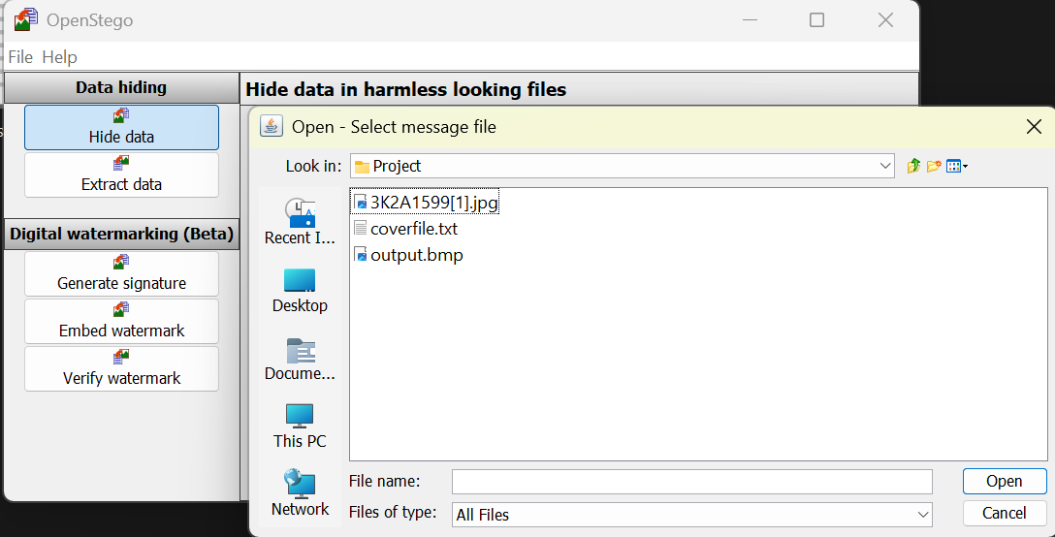
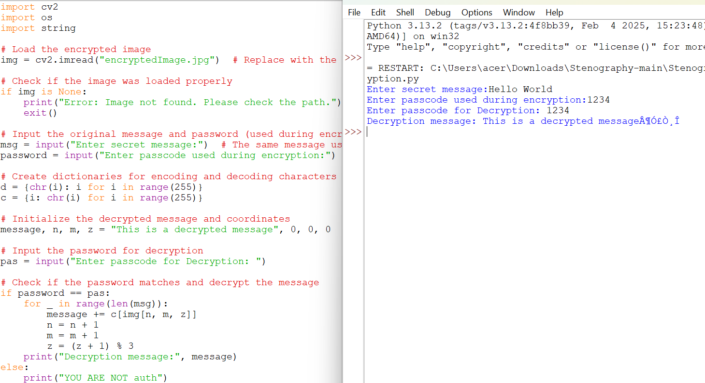
Results
Encrypted Image
OpenStego
Decrypted Message

Slide 8
Conclusion
This project lets people hide secret messages inside pictures.
Only someone with the right password can find and read the hidden message.
It incorporates password-protected encryption, supports various image formats, and ensure a seamless and user-friendly experience.

Slide 9
GitHub Link
akjstyles/Project-aicte-aman

Slide 10
Future scope(optional)
Future Scope
Manager in IT (vendor management) so not so strong in technical skills, need to hone these skills.
Need to work on GUI based setup
Need to work on Broader implementation of Steganography.

Slide 11
THANK YOU

